Slide 1
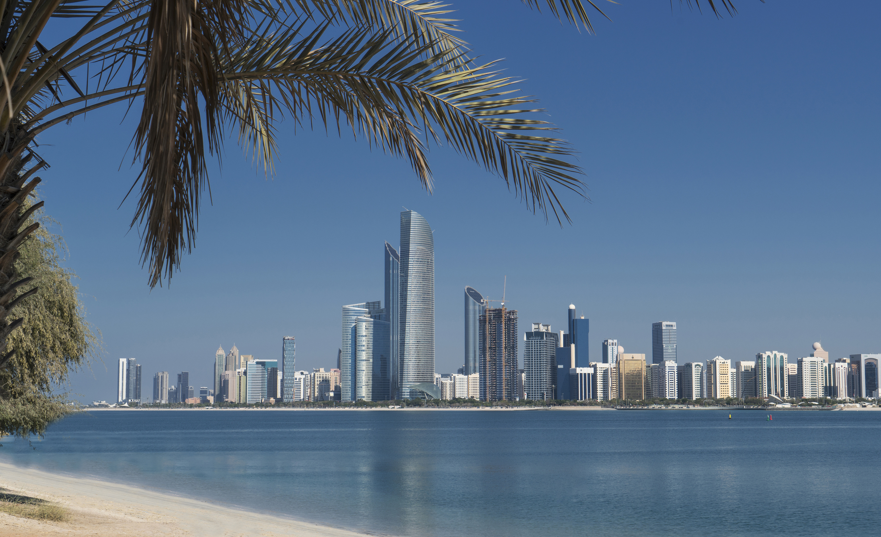

Abu Dhabi, UAE
7-9 November 2023
Promotional Kit

Slide 2

Customize your own banner
to promote your participation at the AEF!
STEP 1: In the next slide click in the circle to insert your profile picture
STEP 2: Enter a message of your choice in the box
STEP 3: Select all the items on the slide (CTRL+A), click right and hit “Save as picture”
Your banner is ready to use, make sure to include the link to the AEF website !
https://www.iata.org/en/events/all/iata-aviation-energy-forum/

Slide 3

Abu Dhabi, UAE
7-9 November 2023
Type your message here …
You can add your name, your session or any other wording you wish. Reduce font size as needed.

Slide 4
Abu Dhabi, UAE
7-9 November 2023
JOIN ME AT
THE AEF 2023!

